Slide 1


Campus Hires 2024 – Advance C Programming Weekly Assessment
IMAGINE IT. DONE.

Slide 2
Training Planner
Topics | Timeline
Kick Start of Advance C | Feb 16
Module 1 – Quick Refresh on C | Feb 19 – Feb 22
Pre-processor conditions, Dynamic memory allocation and free
Structure Padding, Bitwise operations
Advanced Pointers (Double Pointers, Function Pointers)
Weekly Connect 1 | Feb 23
Module 2 – Data Structures | Feb 26 – Feb 29
Data structure : Single/Double/Circular Linked list Sorting of linked list Types - Quick & Insertion Queues
Stack operations
Hashing Algorithms – Hash Table
Weekly Connect 2 | Mar 1
Module 3 – Threads | Mar 4 – Mar 7
Threads and Signal Handling (Basics)
GDB: Memory Debugging
Weekly Connect 3 | Mar 8
Module 4 – Socket Programming | Mar 11 – Mar 14
Socket Programming
Weekly Connect 4 | Mar 15
Viva Preparation | Mar 16 – Mar 24
Viva | Mar 25 – Mar 29

Slide 3
Module 1 Assessment
1. Write a C program to determine the given number is odd or even using Bitwise operators.
2. Write a C program to count the number of bits set in a number.
Input:
144
Output:
Count of Set bits: 2
3. Write a C program to swap two numbers. Use a function pointer to do this operation.
Input:
84 25
Output:
25 84
4. Write an equivalent pointer expression for fetching the value of array element a[i][j][k][2]

Slide 4
Module 1 Assessment
5. Write a C program to Multiply two matrix (n*n) using pointers.
Input: Output:
Size of Row: 3 Product:
Size of Column: 3 48 39 30
Matrix 1: 102 84 66
2 3 4 129 111 93
5 6 7
8 9 1
Matrix 2:
9 8 7
6 5 4
3 2 1

Slide 5
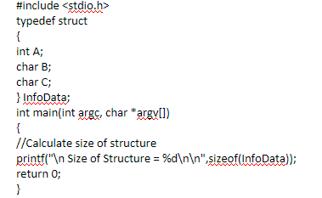
Module 1 Assessment – Guess the output
6. Find the output of the following // Consider the compiler is 32-bit machine

Slide 6
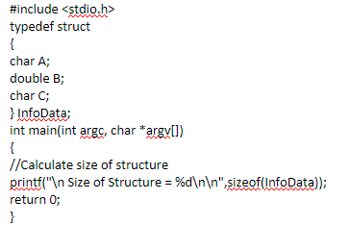
Module 1 Assessment – Guess the output
7. Find the output of the following // Consider the compiler is 32-bit machine

Slide 7
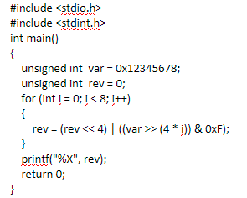
Module 1 Assessment – Guess the output
8. Find the output of the following // Consider the compiler is 32-bit machine

